Slide 1
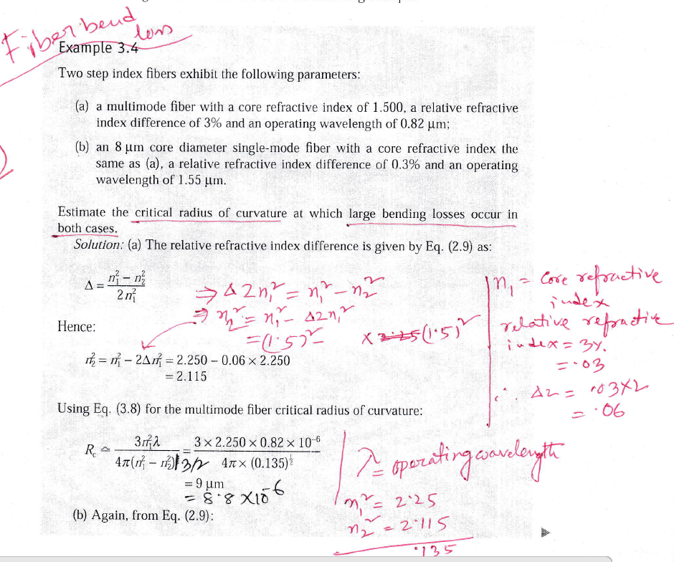

Slide 2
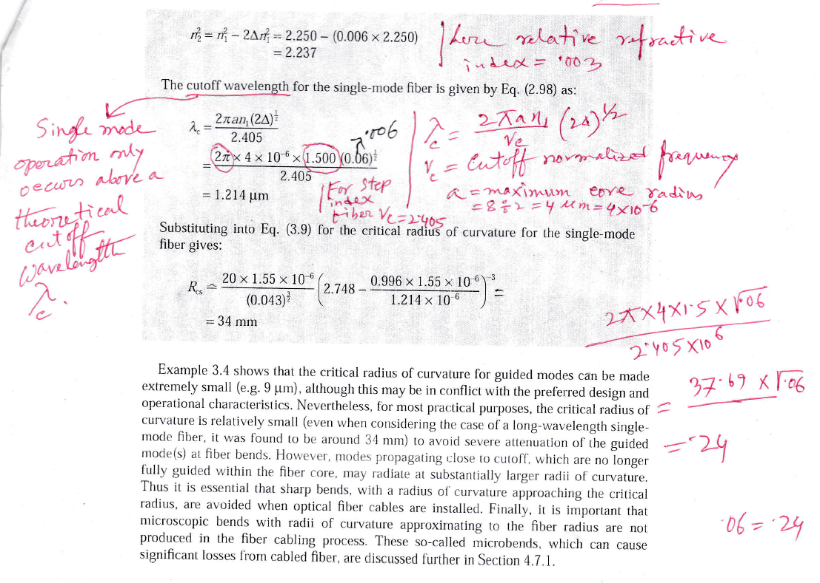

Slide 3
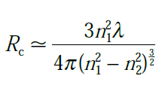
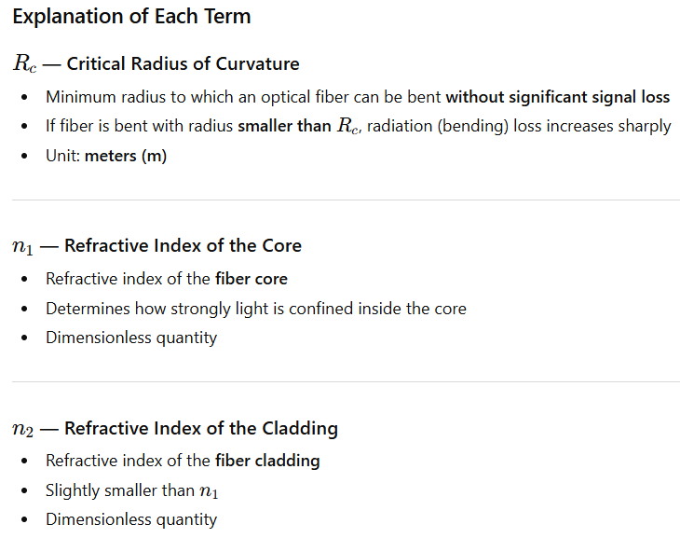
This equation is commonly used in optical fiber communication to calculate the critical bending radius of an optical fiber.

Slide 4
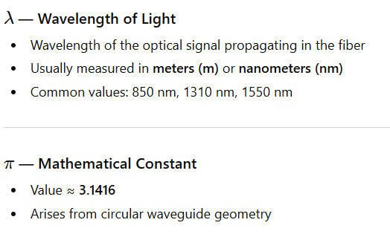
This equation is commonly used in optical fiber communication to calculate the critical bending radius of an optical fiber.

Slide 5
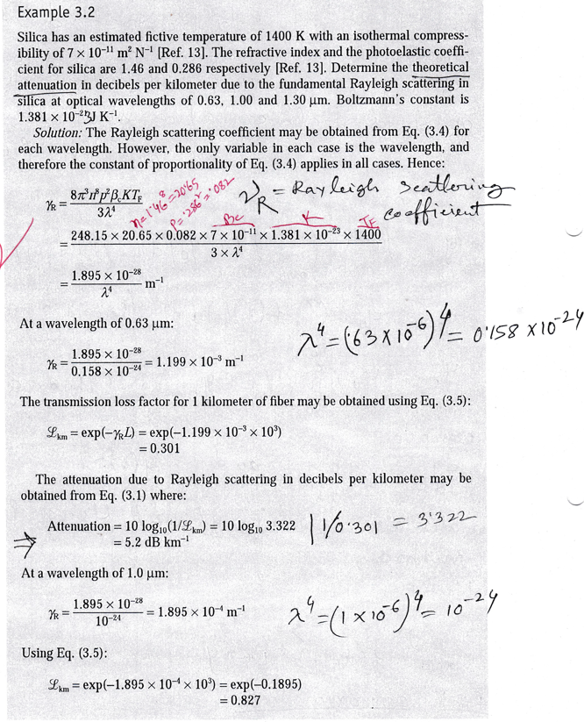

Slide 6
